Slide 1


CPSC 462 – Software Design
Elaboration Phase Iteration 1 Artifact Summary
Professor T. L. Bettens
Fall 2018

Slide 2
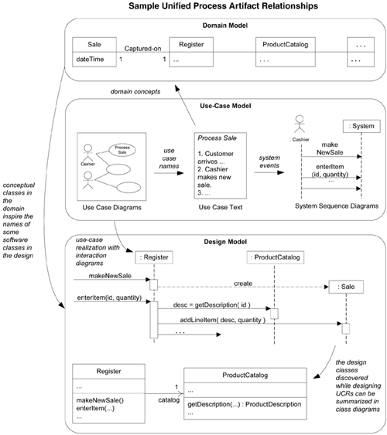
Unified Process Artifacts, Timing, and Relationships
Discipline | Artifact Iteration → | Incep. I1 | Elab. E1..En | Const. C1..Cn | Trans. T1..T2
Business Modeling | Domain Model |  | s
Risk Management | Risk Registry | s | r | r | r
Reequipments | Use-Case Model | s | r
 | Vision | s | r
 | Supplementary Specification | s | r
 | Glossary | s | r
Design | Design Model |  | s | r
 | SW Architecture Document |  | s
 | Data Model |  | s | r
Implementation | Implementation Model (code, html, …) |  | s | r | r
s=start, r=refine
We are here

Slide 3
Two Parts
Artifacts - see following slides
Demo
Should have been successfully dry-ran before class
Each team has 6 to 7 minutes to demo their scenarios
At least three scenarios, one from each fully dressed use case
See next slide for schedule. Be ready at your designated time (hosting computer ready, program ready to launch, etc.)
Provide hard copies of each SSD demonstrated. These are your demo scripts and should be followed exactly. Include on each:
Team member names
Class section
Team number
Scenario and Use Case name
I’ll ask you to walk me through each demo script looking for events and information exchanges
Describe the user goal being demonstrated
Tell me how “complete” the scenario is highlighting stubs and “simplified” steps used in this iterations.
Then show me by executing the steps in the SSD and again highlighting actual versus expected results.
All scenarios shall be executed on the same code baseline

Slide 4
Demo Schedule
Fall 2018 CPSC 462-03 12737 Fall 2018 CPSC 462-01 12689
Team | Approximate Time |  | Team | Approximate Time
1 | 3:05 – 3:15 |  | 11 | 5:05 – 5:15
2 | 3:15 – 3:25 |  | 12 | 5:15 – 5:25
3 | 3:25 – 3:35 |  | 13 | 5:25 – 5:35
4 | 3:35 – 3:45 |  | 14 | 5:35 – 5:45
5 | 3:45 – 3:55 |  | 15 | 5:45 – 5:55
6 | 3:55 – 4:05 |  | 16 | 5:55 – 6:05
7 | 4:05 – 4:15 |  | 17 | 6:05 – 6:15
8 | 4:15 – 4:25 |  | 18 | 6:15 – 6:25
9 | 4:25 – 4:35 |  | 19 | 6:25 – 6:35
10 | 4:35 – 4:45 |  | 20 | 6:35 – 6:45

Slide 5
Refined Inception Phase Artifacts
Risk List / Registry
Use-Case Model
Vision
Supplementary Spec
Domain (Business) Rules
Glossary
Discipline | Artifact Iteration → | Incep. I1 | Elab. E1..En | Const. C1..Cn | Trans. T1..T2
Business Modeling | Domain Model |  | s
Risk Management | Risk Registry | s | r | r | r
Reequipments | Use-Case Model | s | r
 | Vision | s | r
 | Supplementary Specification | s | r
 | Glossary | s | r
Design | Design Model |  | s | r
 | SW Architecture Document |  | s
 | Data Model |  | s | r
Implementation | Implementation Model (code, html, …) |  | s | r | r
s=start, r=refine
All Refined artifacts shall
Incorporate any new information you have learned about your system during this elaboration phase,
Incorporate significant feedback received from the inception phase,
Clearly mark these changes with change bars (or similar) so they are quickly and easily discovered
Add a revision history table summarizing changes made

Slide 6
Refined Fully Dressed Use-Cases
The most significant refines will be to your fully dressed use cases
Create a new section for your System Sequence Diagram(s), and a subsection for each SSD
Summarize the particular, demonstratable path through the use case described by this scenario.
Looking for a paragraph describing what path through the UC has been selected.
Include how complete this scenario is
are there stubs?
have some steps been hard coded
what remains to be done in future iterations to be fully complete.
This is just for this scenario - alternate paths (errors, etc..) are different scenarios
Append your system sequence diagram(s) to the fully dressed UC document
Make certain the Use Case text has been updated and the text and the SSD match exactly
Start your step descriptions with “<Actor> does <event>”
Don’t forget the pre- and post-condition section

Slide 7
SW Architecture Document
Architectural Representation
Summary of how the architecture will be described in this document, such as architectural views. The sections below enumerate the "views“
Architectural Decisions
For each type of decision
Provide two alternatives
Each alternative has class and sequence diagrams set
Make a selection and provide rationale
Provide a reference (link) to Design Model (class and sequence diagrams) where the selected option appears
Low Coupling / high cohesion
Creator
Information Expert
Controller
Identify which Controller sub pattern (façade controller or session controller) is being used
Logical View
Package Diagram
UI, Domain, &Technical Services layers clearly identified
Your sub packages within Domain layer identified
Class diagram showing just the Interfaces to the Domain and Technical Services layers
Domain layer function signatures match SSD exactly
Domain Model View
May optionally be a sperate artifact
Design Model View
May optionally be a sperate artifact

Slide 8
Domain Model
A single diagram capturing the system’s concepts and relationships between those concepts
Relationships have roles and multiplicity
Bounded by the iteration's scenarios
Capture significant concepts and attributes in the Glossary

Slide 9
Design Model
Dynamic View
Software sequence or communication diagrams
Make each diagram a new, numbered subparagraph
Static View
Software class diagrams
Make each diagram a new, numbered subparagraph

Slide 10
Implementation Model
System build instructions
Procedures, scripts, etc.
Source code to design cross-reference
Cross reference from Software Class Diagram to Class implementation
What source and header file implements the class. Sort this list by class name.
Annotate the Class Diagram with the header file information
Cross reference from GRASP pattern to implementation
Show (point to) an example in the code where each of the 5 GRASP patterns is implemented.
Cross reference from layer interface in Logical View to code
Show (point to) the code where Domain Layer and Technical Services Layer interfaces are implemented.
Source code
Zipped into a single file preserving directory structure.
The root of the directory tree shall contain main()
Everything else shall be in a sub-package (sub-directory)
Directory, package, and namespace exactly hierarchy match
#includes should be relative to the root (#include "DomainLayer/Register/RegisterHandler.hpp" for example)

